Slide 1
Apple Computers, Inc.
Institution Affiliation
Students’ Name
Date of Presentation

Slide 2

Apple Computers, Inc.
Apple Inc. is a multinational technology company that has its headquarters in California, Cupertino.
Its primary function is designing, developing, and selling electronic goods, offering online services as well as providing computer software.
It provides electronic goods like iPhones, personal computers, iPod portable media players, etc. it also offers services such as iOs App Store, Apple Music, Apple Care, and iCloud.
Generally, they provide public goods and services across the world to their interested customers.

Slide 3
Cont..
Apple Inc. is an Oligopoly company that has a limited level of competition.
Its market is shared by a few numbers of producers and sellers.
This is an oligopolistic and a monopolistic competition Company because it has many competitors.
It still upholds its rank in the market of the technology industry as it’s costly as well as difficulty for their competitors to get into the market.

Slide 4
Cont..
Apple Inc. is a privately owned enterprise that was established by Steve Jobs, Ronald Wayne, and Steve Wozniak in the year 1976 by developing and selling Wozniak's Apple I personal computers (Finkle & Mallin 2010).
The company operates its business across the world.
Its enterprises are situated in Europe, China, Asia, and America. In America, it has its segments in North and South America.
Their regional enterprises offer the same goods and services, and they are well managed distinctly while considering the appropriate location of their customers and distributors.

Slide 5
Cont..
Tsai & Chang's (2018) statistics show that Apple Inc. has sold to over 1.3 billion iPhones worldwide after releasing iPhone 1 in 2007.
They have experienced a steady increase in the sales of smartphones from the third quarter of the year 2007 to the second quarter of 2018, as shown in the graph below.
Their output value in dollars in 2018 amounted to a total of 260.17 billion.
The sales from iPhones generated over 218 billion dollars, which was 82 percent of the total output of the company.

Slide 6

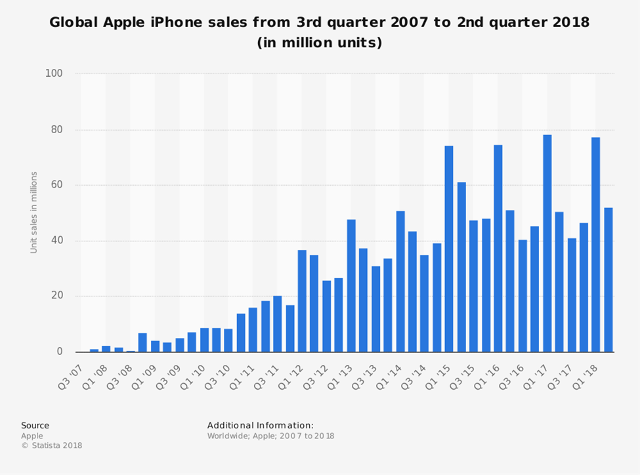
Graphical representation of the Global Apple iPhone Sales from 3rd quarter 2007 to 2nd quarter 2018 (in million units)
https://mediakix.com/wpcontent/uploads/2018/07/gloaliphone-sales-apple-statistics.png

Slide 7
Cont..
The stock value of Apple Inc. increased by 15,000 percent from the year 2001.
Tsai & Chang (2018) said that this made it have a net worth of almost 1 trillion dollars.
Its output value increased when the company became famous worldwide.
From the graph below, the stock took off in 2001 with 1.97 dollars per share and rose tremendously to 207.39 per share in 2018.
This was an increase in the value of the output of 15,966 percent for 18 years (Tsai & Chang 2018).

Slide 8
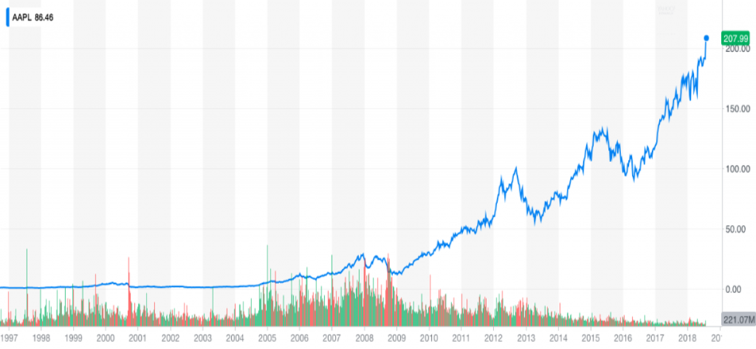
Graphical representation of output from 2001 to 2018

Slide 9
Cont..
According to Lindsay (2018), one of the top shareholders is Arthur Levinson, with a share of about 1.16 million dollars. He is the chairman of Apple Inc. Company.
The second top shareholder is Tim Cook, with the share of 901,474 dollars.
Thirdly is Craig Federighi, with a total share of 460,367 dollars. He is the top-ranked vice president of software engineering, working on the development of Apple’s operating systems.
There are also other institutional shareholders such as the Vanguard Group and Blackrock owning 15.93 percent of the total shares of the company.

Slide 10
Cont..
Apple is one of the most valuable technology companies across the world.
It is among the top companies that manufacture smartphones like Samsung and Huawei.
In its operations of manufacturing electronic equipment, marketing, and offering online services, they have employed more than 120,000 personnel in their enterprises.
They have established over 500 retail stores in their segments. They operate the iTunes Store, which is the largest retailer of music worldwide.

Slide 11
Cont..
Their primary function is to design, develop electronic equipment, offering online services, and providing computer software.
They produce electronic goods such as iPhones, personal computers, and iPod portable media players.
They also provide services such as iOs App Store, Apple Music, Apple Care, and iCloud.
Generally, they produce public goods and services across the world to their interested customers with a significant focus on technological improvement (Linzmayer 2004).

Slide 12
Cont..
Apple Company takes advantage of the unique value proposition.
According to Graham (2008), it’s a great marketing strategy that favors the value of its products.
This is a marketing strategy that is more effective on social media websites and platforms, as well as creating a competitive advantage in the market.
On sales, they are fast, primarily, when they have produced a new item, or when they have established new services, they make sure that all the regions that sell their products get access to them in the shortest time possible (Writer 2018).
They are well advanced, and they have their own social media pages that are used to address complaints raised by their customers.

Slide 13
Cont..
Although it is an Oligopolistic company, they have many competitors, but they work hard to provide their best to their customers.
They use the uniqueness of their products to outdo their competitors.
They are not highly focused on competition with others.
For instance, their products are most expensive than that of their rivals, but just because they offer top-line features and proper specifications in their products makes them outdo their competitors.

Slide 14
References
Lindsay. J (2018) article about; “who owns Apple and who are the biggest shareholders?” https://metro.co.uk/2018/08/03/owns-apple-biggest-shareholders-7793058/. Retrieved 2019.
Tsai, W. L., & Chang, P. T. (2018). Combining data envelopment analysis and competitive dynamic theory for exploring global smartphone manufacturers' performance. JABS, 4(2), 109-125.
Graham, H. (2008). Marketing strategy and competitive positioning. Pearson Education, India.
Linzmayer, O. W. (2004). Apple confidential 2.0: The definitive history of the world's most colorful company. No starch press.
Finkle, T. A., & Mallin, M. L. (2010). Steve Jobs and Apple, Inc. Journal of the International Academy for Case Studies, 16(7), 31.
Writer, H. (2018). Case Analysis: Apple, Inc. Essay. Marketing.

